Slide 1
Journey PPT
AASTHA SINGH
TECHNICAL TRAINING WEEK -2
28TH AUGUST 2023- 2ND SEPTEMBER 2023

Slide 2
DAY 1 DBMS Big Data
Topics covered:
Introduction to DBMS ,we started the session with a formal, we talked about what was the importance DBMS and how it works with projects.
Importance of DBMS concepts, we discussed various concepts of DBMS discussing how a database must function.
ACID properties
Big data concepts, We talked about Big data and discussed how traditional techniques we ineffective and not usable against it.

Slide 3
Day 2 Data warehouse
A review was done of the ER Models.
A data warehouse is a central repository of information that can be analyzed to make more informed decisions.
A centralized database is basically a type of database that is stored, located as well as maintained at a single location only. This type of database is modified and managed from that location itself. This location is thus mainly any database system or a centralized computer system.
Data mart.
Data Cleaning Process- denormalize the data, Remove duplicate values, replacing the null values, decoding the data, timimg the data,data correction, filteration of data, data calculation and data sorting.

Slide 4
Day 2
Characteristics of Big Data- Volume, Variety, velocity
Big data eg.- NYSE, FACEBOOK, JETENGINE,etc.
Discussed more about Hadoop and blocks
Different types of node- Name, Data, JobTracker, Task Tracker are some kinds of nodes. YARN(Yet Another Resource Negotiator)
Discussed some Hdfs commands and MapReduce.
Language names Pig and Hive.

Slide 5
DAY 3 Data lake and Azure SQL
We Started the day by discussing about Data lake.
Data Lake can be structured, unstructured and semi structured data.
But data warehouse can be only structured.
Then further discussion was on data lake gen1, gen2 and differences between data lake and data warehouse.
Microsofts implementation of SQL is called Transact sql, Declarative not procedural.
In 1970's the product called 'SEQUEL', structured English query language, developed by IBM and later SEQUEL was renamed to 'SQL' which stands for Structured Query Language.
In 1986, SQL was approved by ANSI (American national Standards Institute) and in 1987, it was approved by ISO (International Standards Organization).

Slide 6
DAY-3
DDL(Data definition): for physical structure
Create : create schema
Alter : modify schema
Drop: delete schema/ resource
DML(Data manipulation): for logical info.
Insert
Update
Delete: delete data but with a filter on.
Select
Truncate: delete all data but save the table .
DCL(Data control): Permission, access etc.
Grant : Give permission to a request
Revoke: take away both whatever had been given
Deny: say no to a request or restrict permission

Slide 7
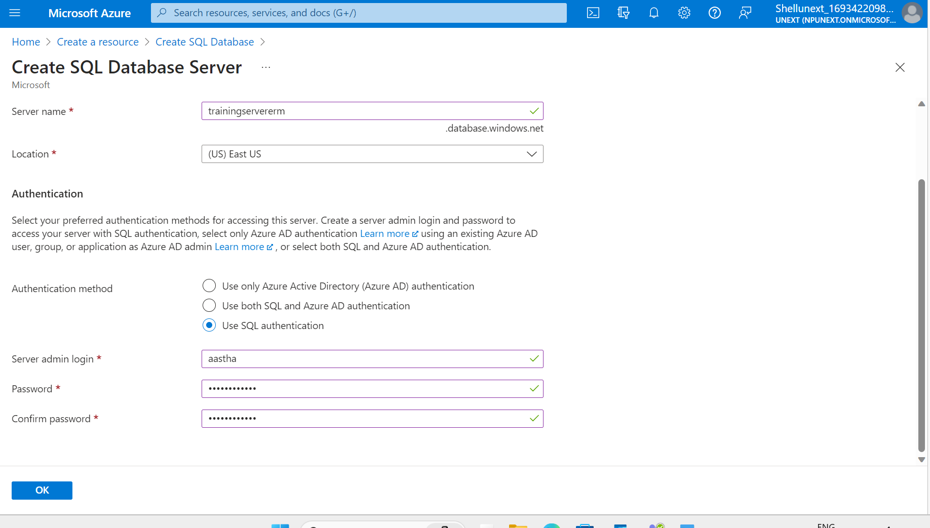

Slide 8
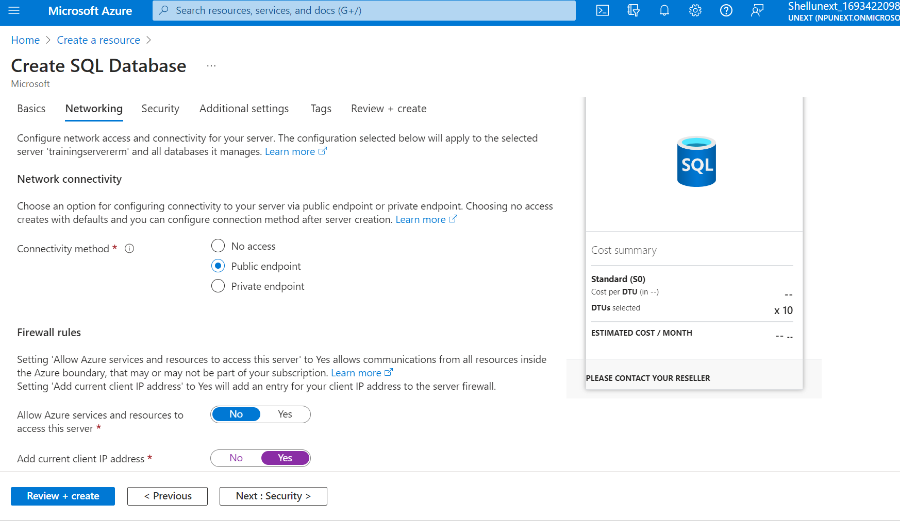
Click on “Review and Create” then Create.

Slide 9
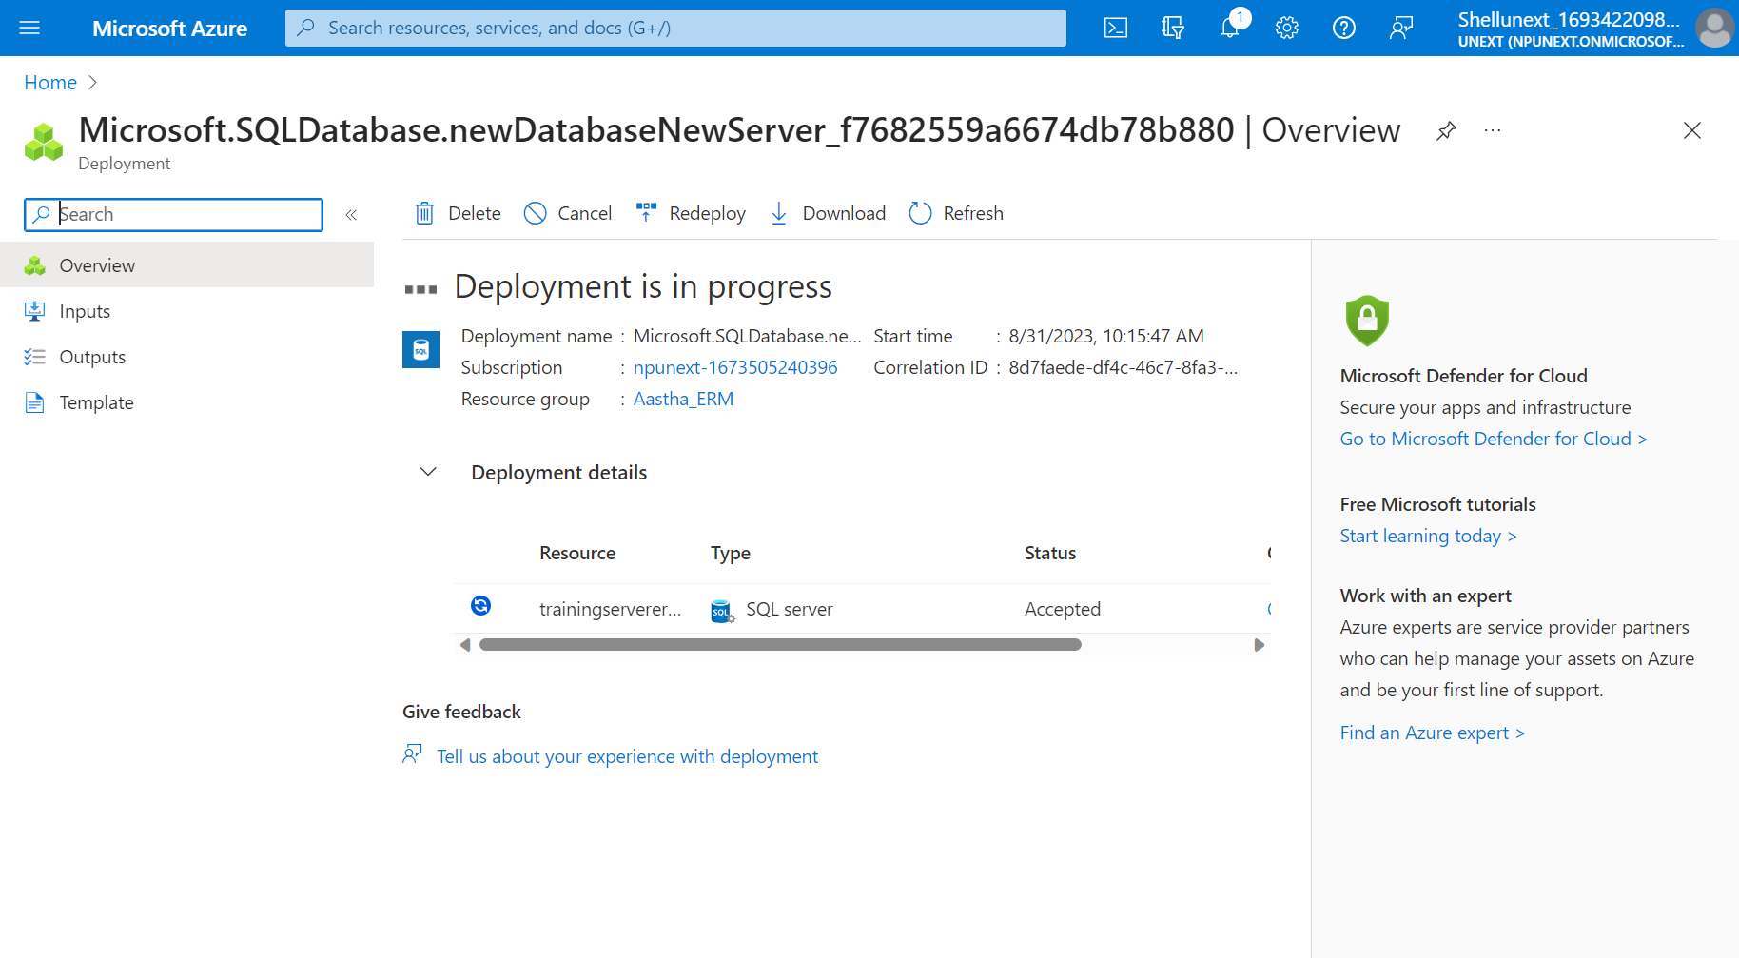

Slide 10
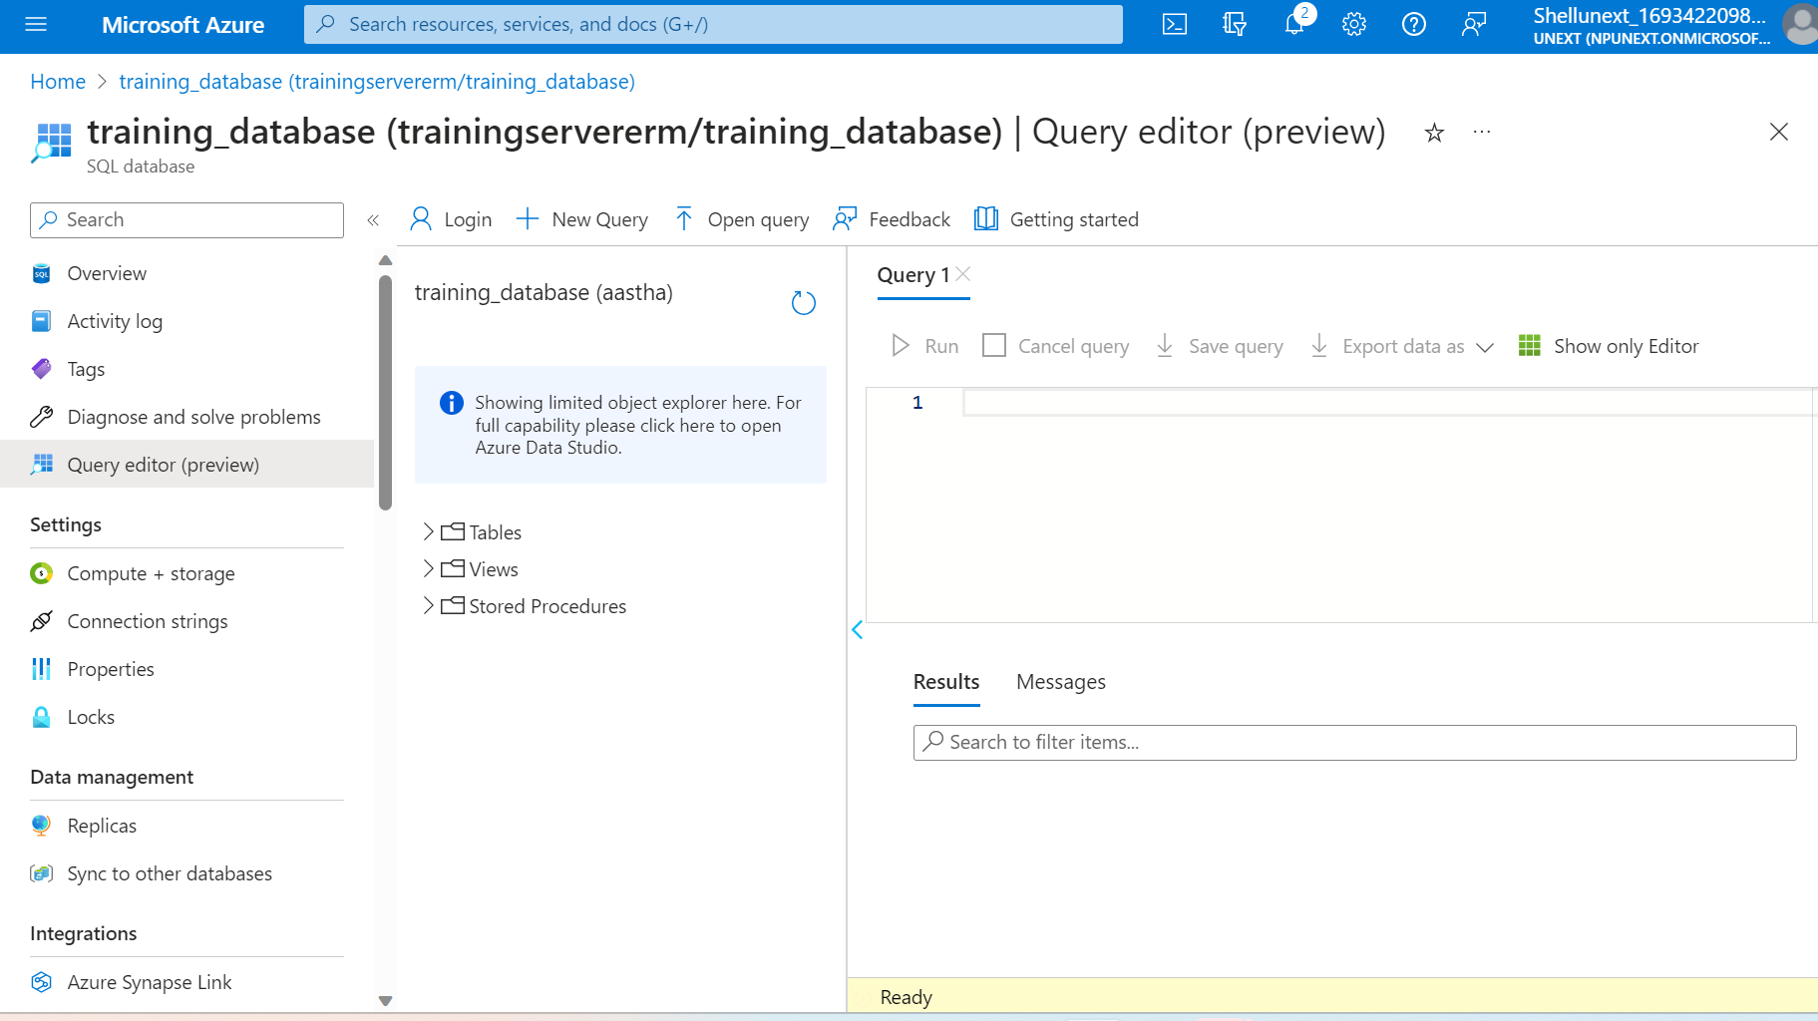

Slide 11
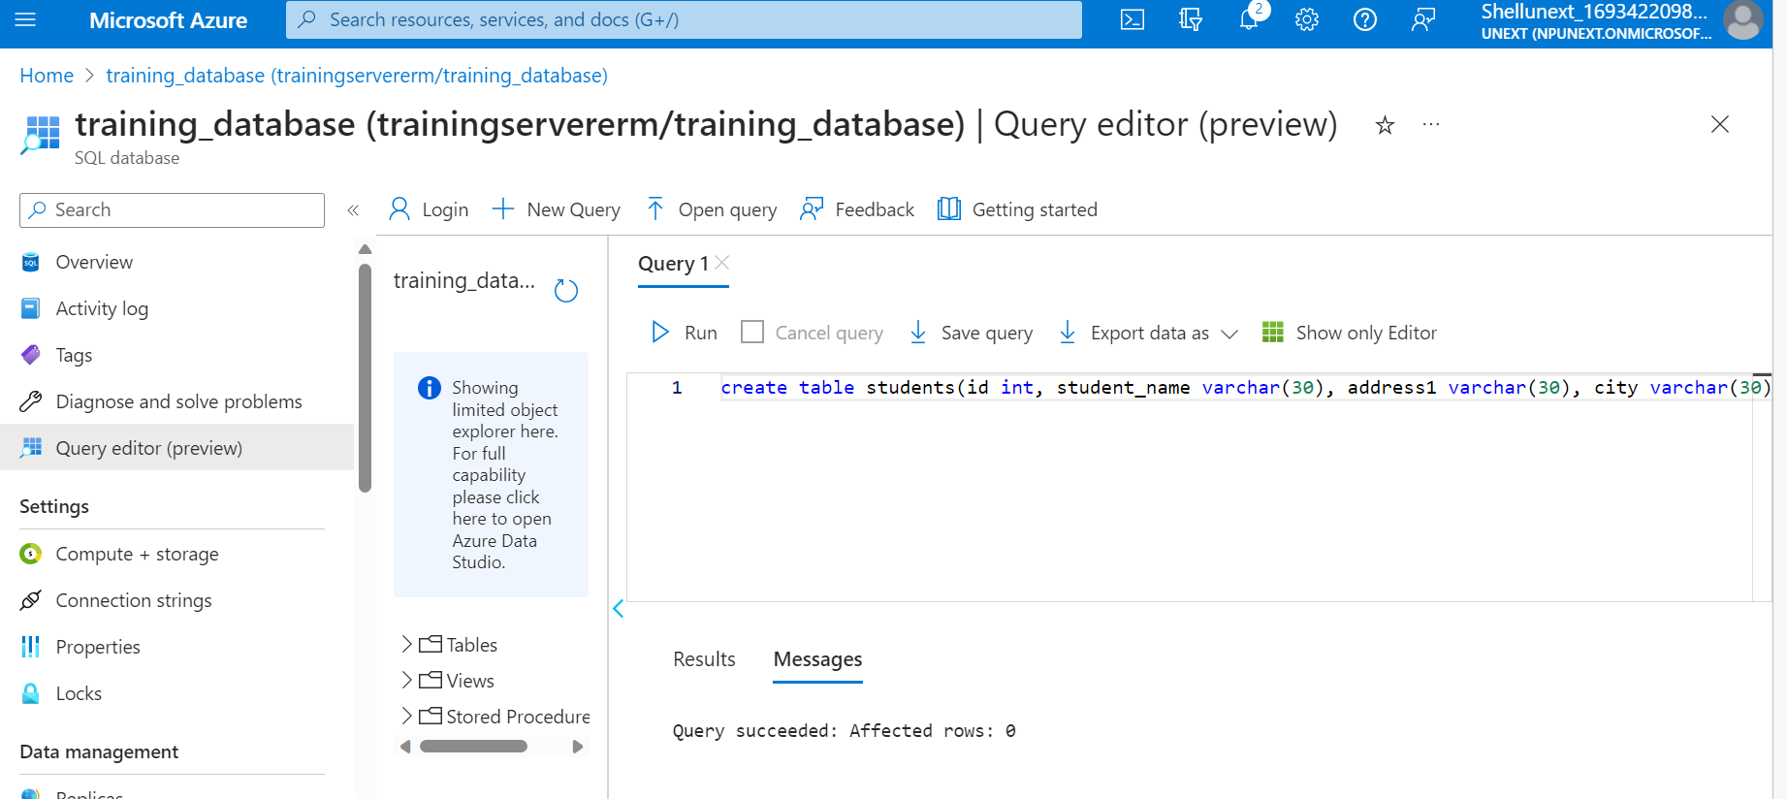

Slide 12
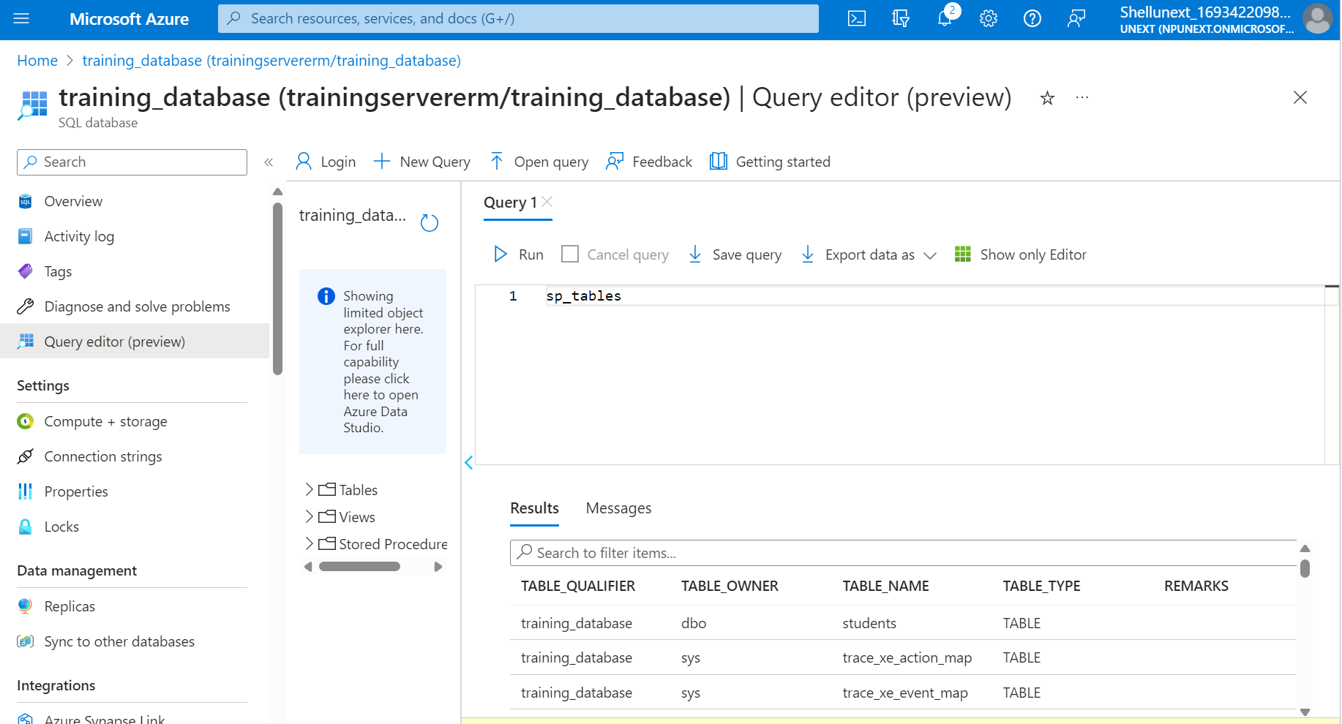

Slide 13
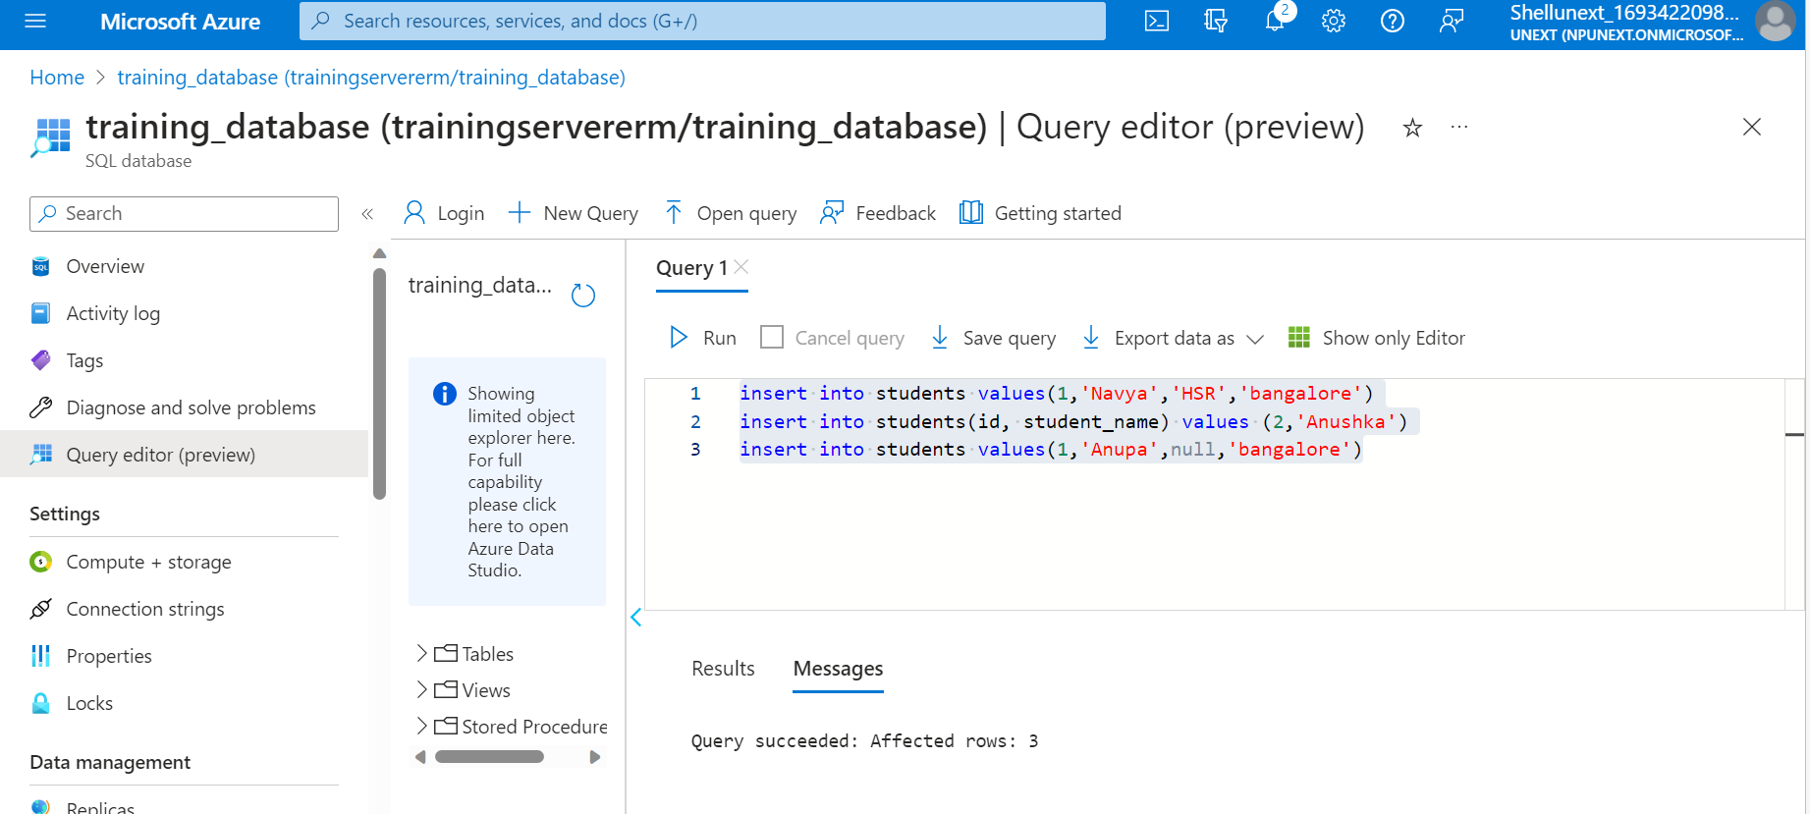

Slide 14
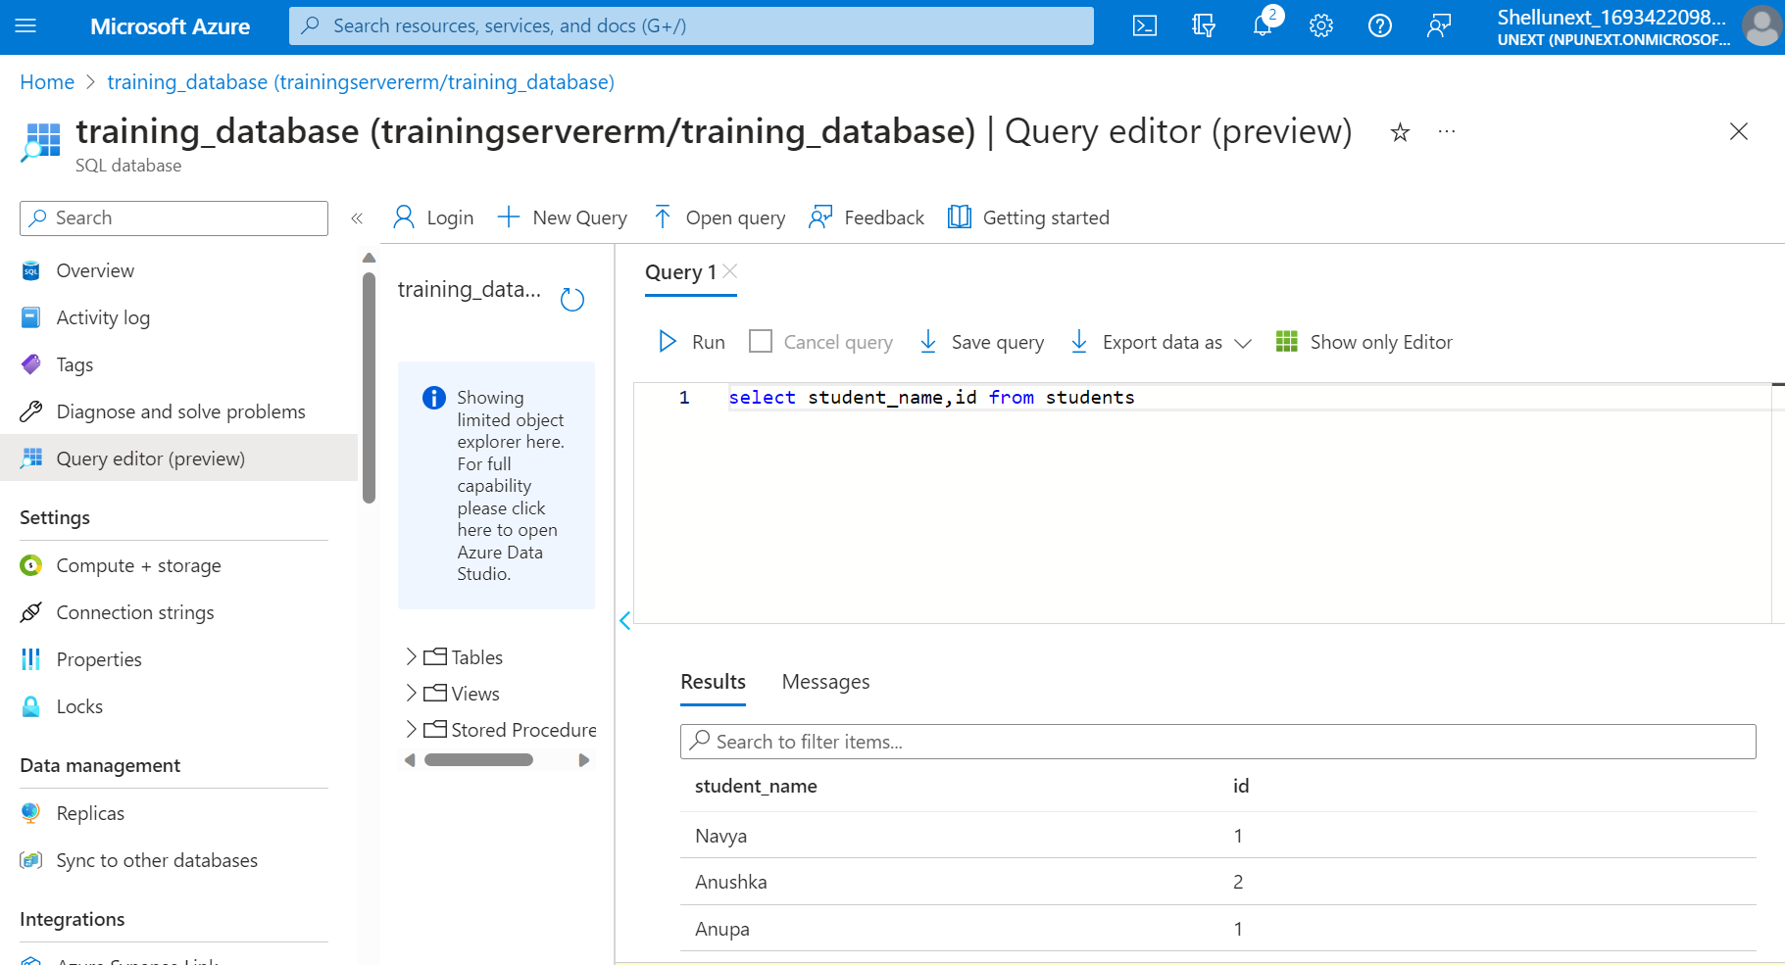

Slide 15
DAY 4
Different Types of SQL JOINs
Here are the different types of the JOINs in SQL:
(INNER) JOIN: Returns records that have matching values in both tables
LEFT (OUTER) JOIN: Returns all records from the left table, and the matched records from the right table
RIGHT (OUTER) JOIN: Returns all records from the right table, and the matched records from the left table
FULL (OUTER) JOIN: Returns all records when there is a match in either left or right table

Slide 16
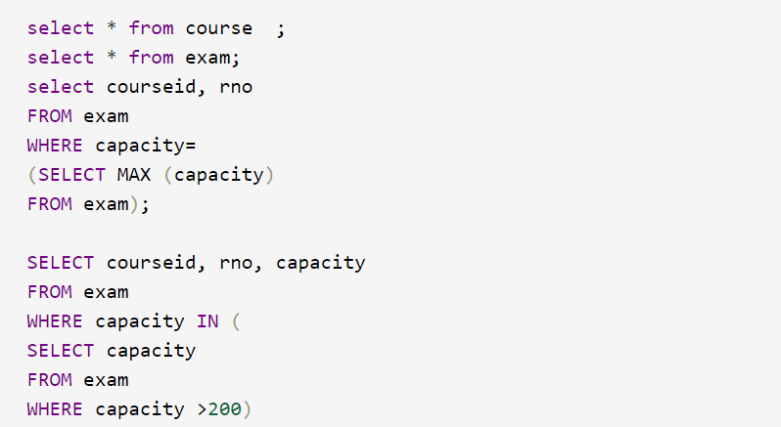
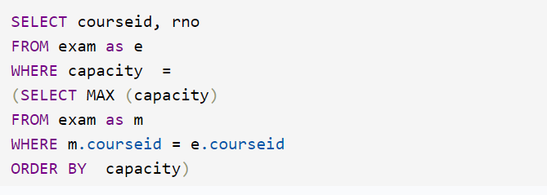
DAY 4
SubQuery

Slide 17
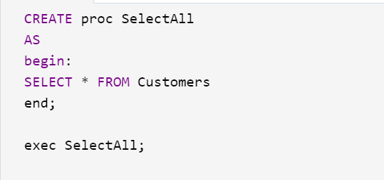
Procedures

Slide 18
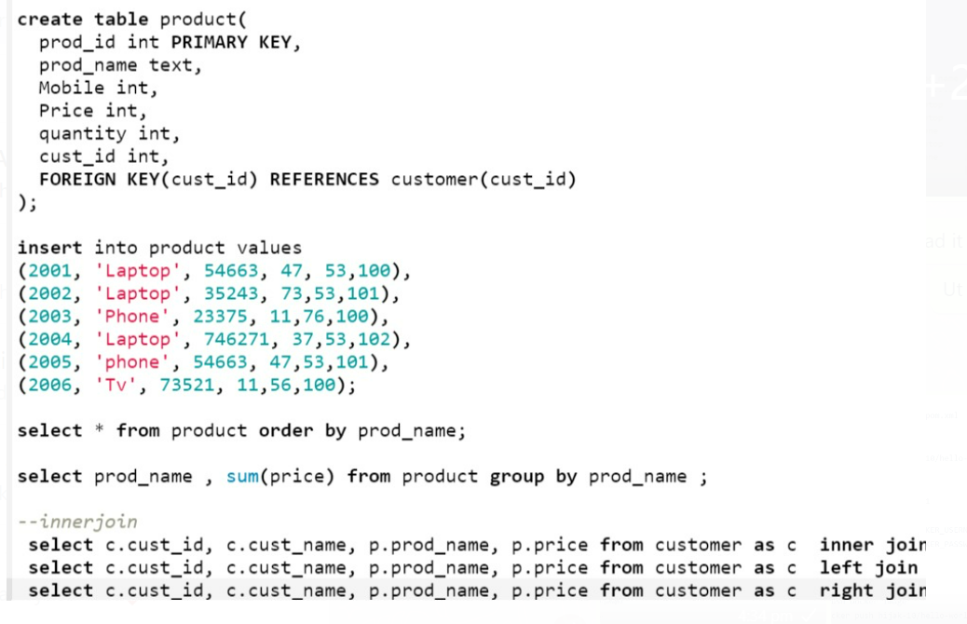
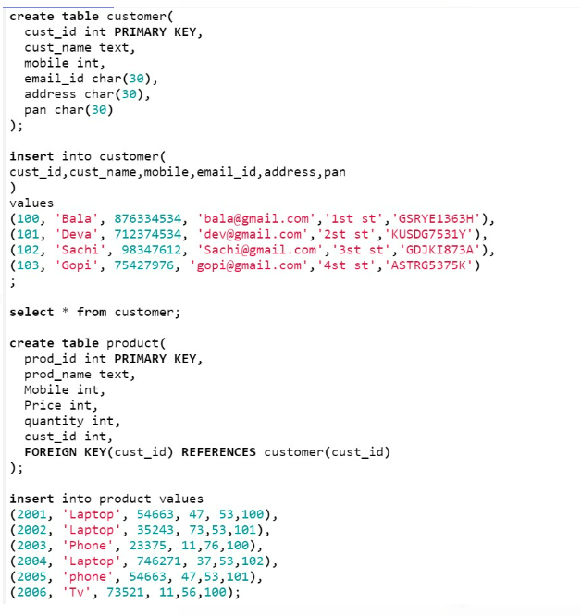
SQL IMAGES

Slide 19
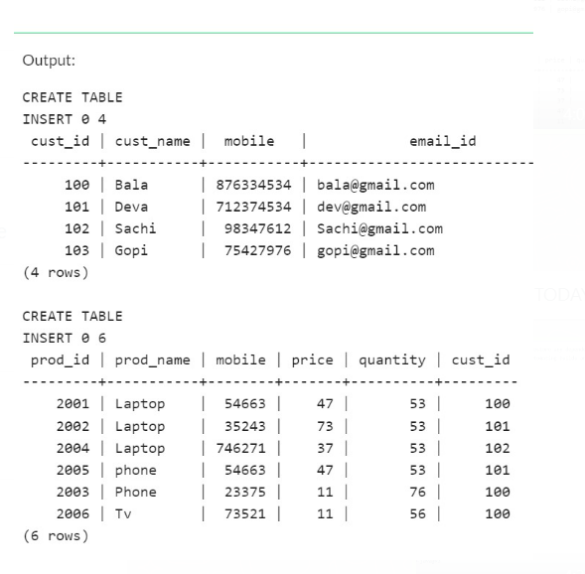
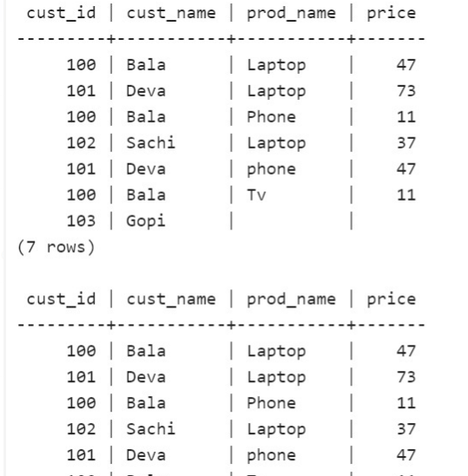
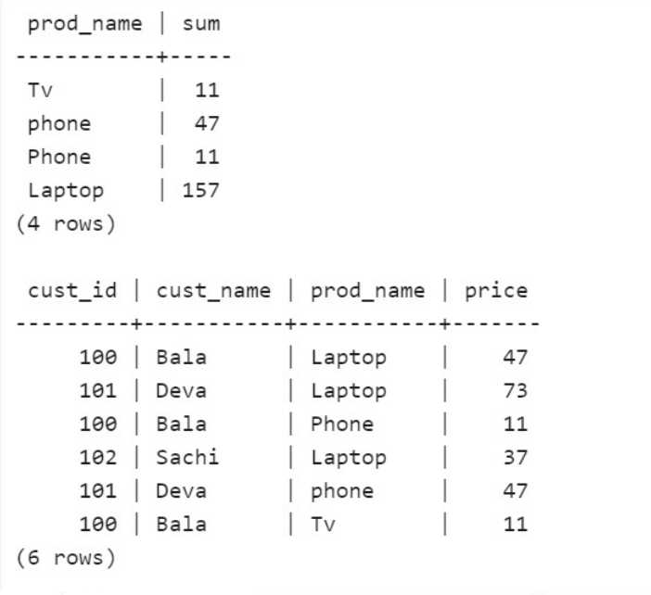
SQL Outputs

